Slide 1

Capstone project North wind sales analysis
Deepak Kag (Batch DA-4)

Slide 2
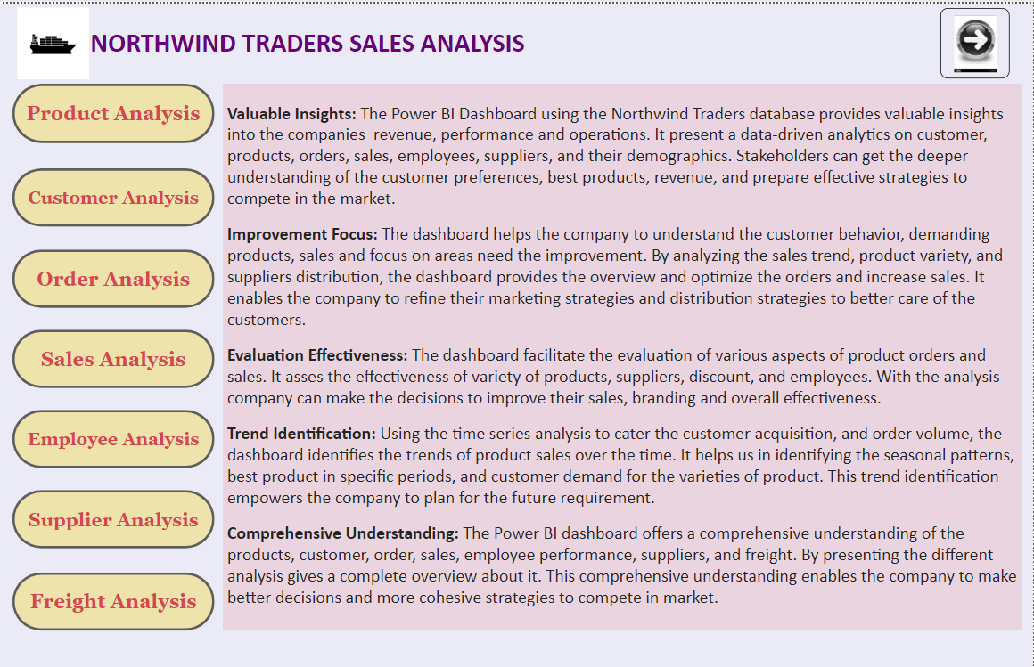

Slide 3



Objective: The objective of this project is to create a comprehensive Power BI Dashboard utilizing the Northwind Traders database. The dashboard aims to provide the valuable insights into the product variety, customers, demographics, demand, suppliers, and shippers enabling the data driven decision-making and strategic planning.
Analysis Scope: The analysis focus on various aspects of the product categories, sales of products, customer, employees and suppliers distribution, order and delivery time and impact of discounts. I will encompasses the time series analysis of sales of product categories and acquisition of customers across countries.
Goal: The primary goal of this Power BI dashboard is to offer a detailed overview of the products, customers, their demographics, product review, cost, and employees performance. It will provide the actionable insights for the sales, availability of suppliers, and shippers, and identify opportunities for growth and competitive enough to sustain in the market.

Slide 4



Insights & Recommendation: The Power BI Dashboard provides valuable insights into the companies revenue, performance and operations. It will analyze the customers, products, orders, sales, employees, suppliers, and their demographics. Stakeholders can get the deeper understanding of the customer preferences, best products, revenue, and prepare effective strategies to compete in the market.
Report & Presentation: The final deliverable will consist of a detailed report describing the data source, data modeling methodologies, and data cleansing processes used in creating the Power BI dashboard. The report will also include a step-by-step guide on how to interpret the insights and use the dashboard for decision-making. The presentation will showcase the key findings, visualization, and actionable recommendation derived from the dashboard’s analysis.
The Power BI Dashboard, along with the report and presentation, will serve as powerful tool for the Northwind Company’s stakeholders. It will empower them to make informed decisions, optimize sales strategies, product verities, suppliers, on time delivery, and enhance the business performance in the competitive traders market.

Slide 5
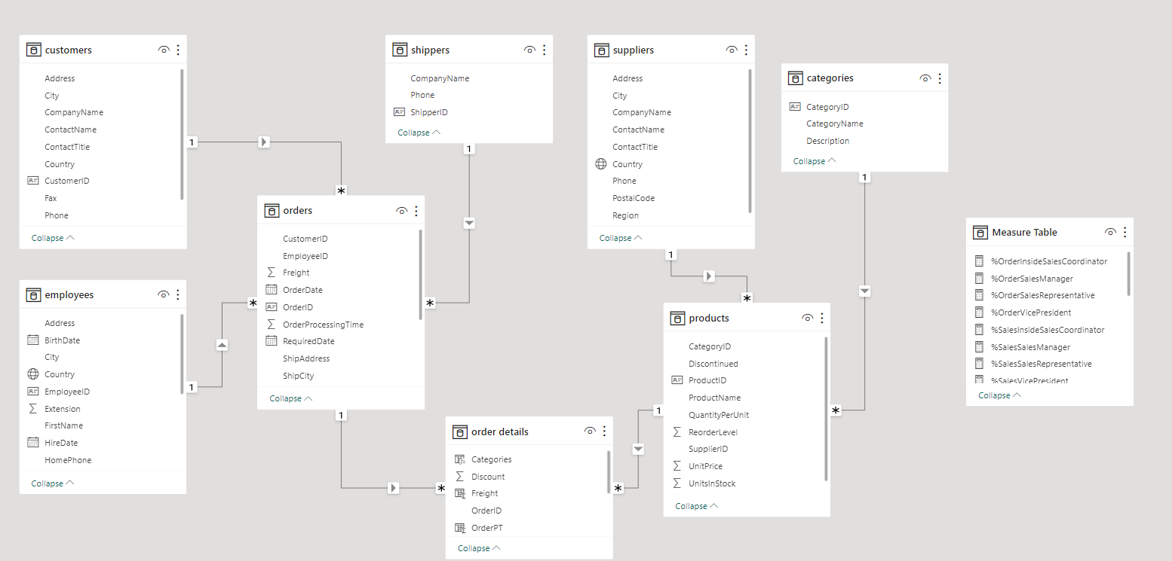
ER Diagram

Slide 6
Power BI Problems
Statement

Slide 7
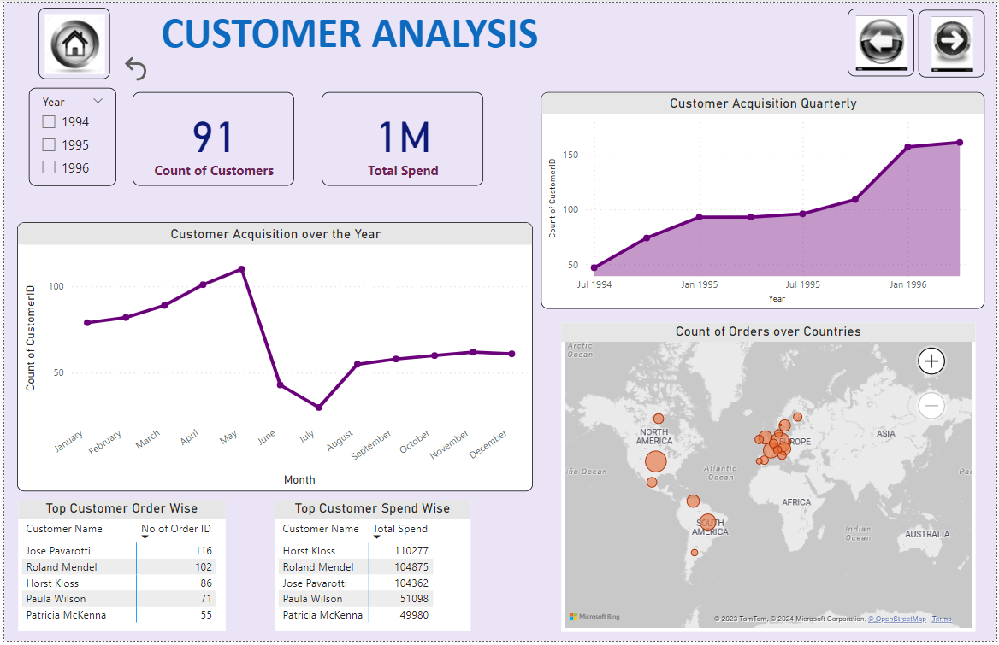

Slide 8
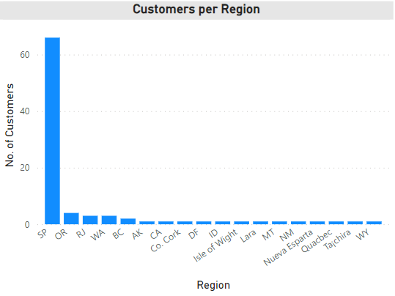
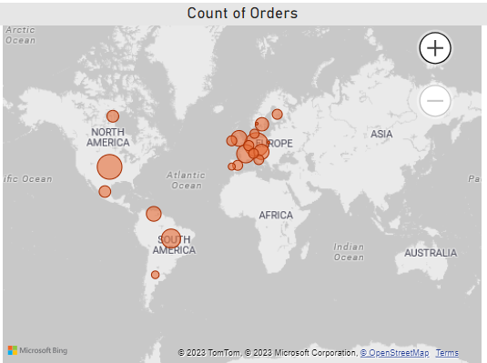
Q1: How does customer distribution vary across different regions or customer segments? Can we visualize it on a map or bar chart?
Gleaning from the customer analysis, it becomes apparent that the region named SP will have the highest number of customers. Apart from the remaining 17 regions. The SP region lies in the country UK. The other report showcase the demographic distribution of orders across the customer countries. The bubble size indicates the number of order placed and number of bubbles indicates the customers in that region. The bubble intensity is high in the European continent and hance the number of customer are more in that region.

Slide 9
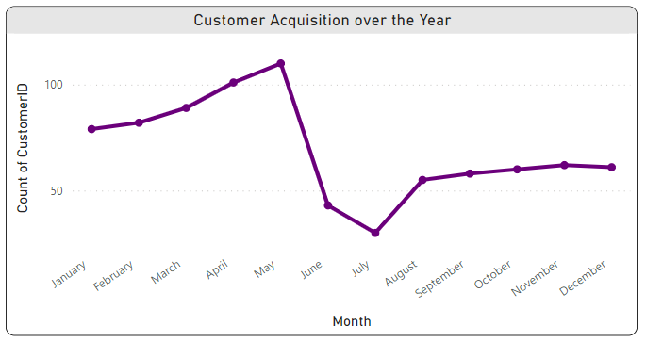
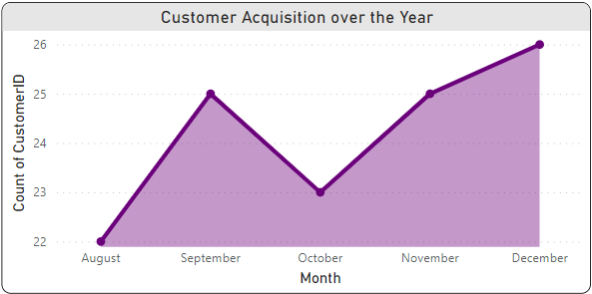
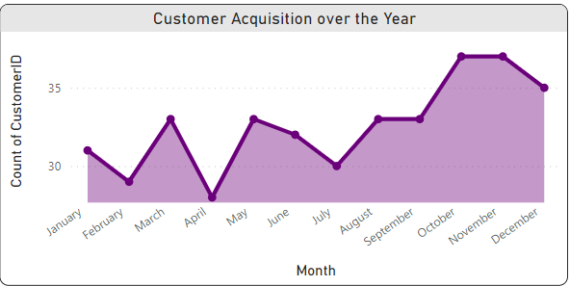
Q2: What is the trend in customer acquisition over time? Can we create a line chart or area chart to display it?
Gleaning from the customer analysis, it becomes apparent to visualize the customer acquisition over the years, quarters and months. In the year of 1994 shows a positive trend initially and becomes almost in the last quarter of the year. In year 1995 the no. of customers shows a positive trend throughout the year and contribute maximum to the sales, and in year 1996 initially in the 1st quarter the customers count increases and letter in the end of the 2nd quarter there was a sudden fall in the customer acquisition. Which opens a new lead for the other analysis to understand the fall of the customer count.

Slide 10
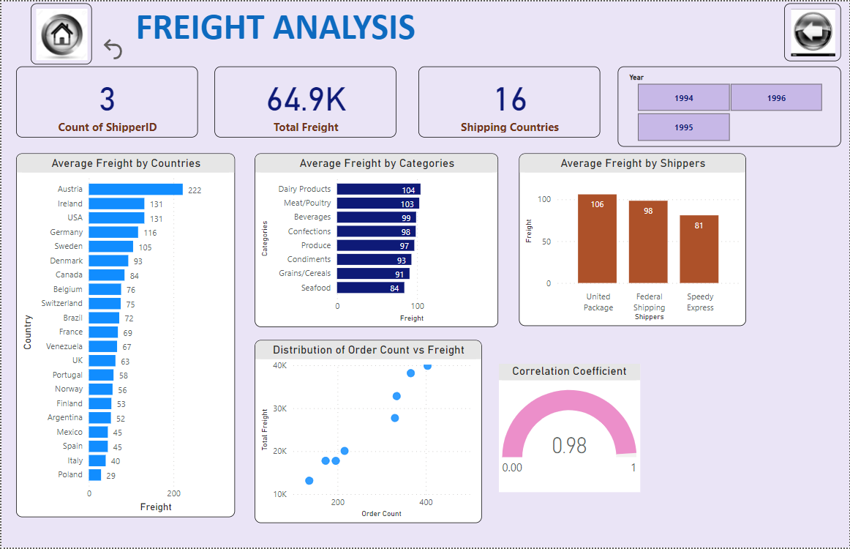

Slide 11
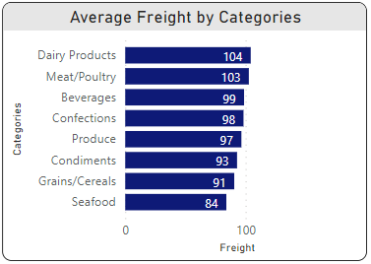
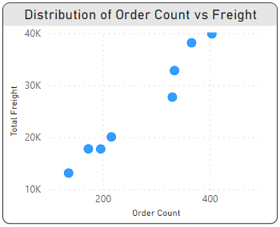
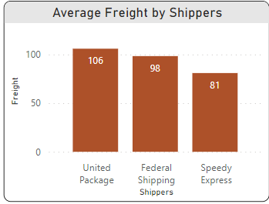
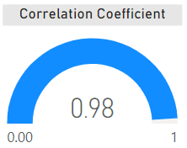
Q3: Can we visualize the distribution of customer demographics such as age, gender, or income using histograms or pie charts?
Note: There was no such data available in the database which tells us about the customer age, gender, and income. So we did the analysis of freight to understand about the freight charges involved with the different product categories, shippers charging and understand the relationship between freight charge and quantity ordered.
Gleaning from the Freight Analysis, it becomes apparent to visualize the freight charges are high for the categories Dairy product, Meat/Poultry, Beverages, and Confections. The average cost for the shipping mode United packages is charging highest for the transport of the products. We also try to find the correlation between orders and freight charges, found that there is a +ve correlation between them with a value close to 1. The particular analysis helps us to understanding the shipping charges.

Slide 12
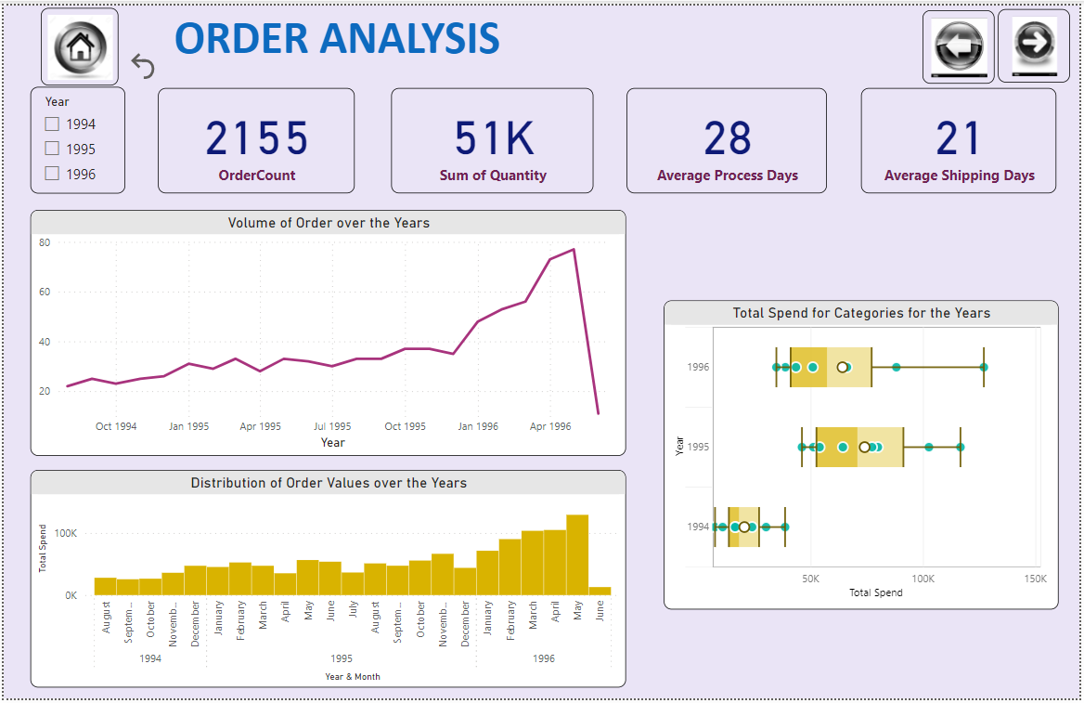

Slide 13
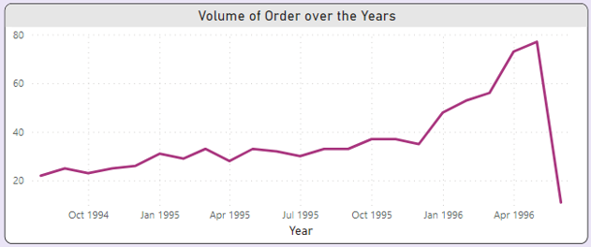
Q4: How does order volume change over time? Can we create a time series chart or stacked bar chart to visualize it?
Gleaning from the Order Analysis, we can visualize the change in order volume over time. Order volume is defined as the number of customers offered a something within the time frame. In our case we have considered a period of 3 years for which a data has been provided. Order volume tells the insights of the customer purchasing behavior. From the plot we can understand that the order volume increases throughout the time period but in the end of 2nd quarter of year 1996 the order volume have a sudden fall. Because in this timeframe the customer acquisition falls leading to decrease in orders and leads to drop in the sales.

Slide 14
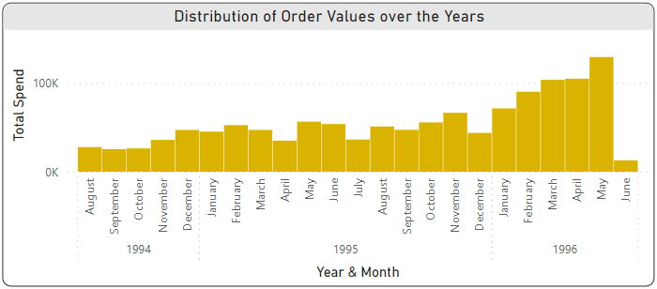
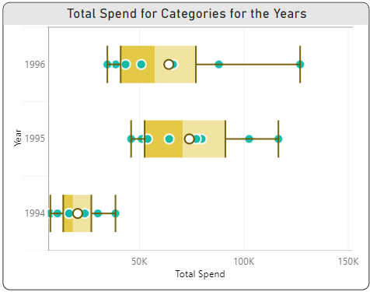
Q5: What is the distribution of order values? Can we create a histogram or box plot to display it?
Gleaning from the Order Analysis, we can find out that the distribution of orders over the years. We can interpret from the graphs that the order value is increasing from the year 1994 to 1996. After the end of the 2nd quarter of 1996 there is a drop in demands. We have also visualizes the order value across different categories and found that the category Beverages and Dairy Products are the one which have the huge demand and have a highest number of orders as compare to other categories. The mean value for the orders is 20.3K, 73.8K, and 64K in the year 1994, 1995 and 1996 respectively. From this visualization we understand that we have make changes in our strategies to overcome the drop in values after May 1996.

Slide 15
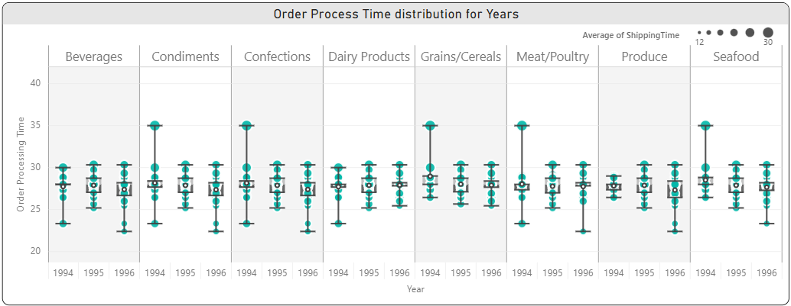
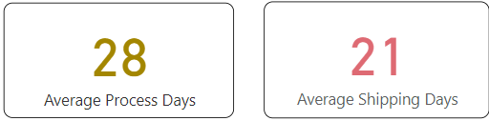
Q6: Can we visualize the average order processing time or shipping duration using a bar chart or box plot?
Gleaning from the Order Analysis, we visualize and interpret the order processing time (required date – order date) which gives a idea about the in how much time the product is going to deliver. The box and whicker plot represent the distribution of order processing time over the years for different categories of product. We can understand that the strategies are implemented well throughout the years because the time is reducing for the next years. The average processing time of all the products is 28 days and shipping time (shipping date – order date) is 21 days. Order process and shipping time can help us in understanding the customer satisfaction also. There is a room to reduce the time to provide the better services.

Slide 16
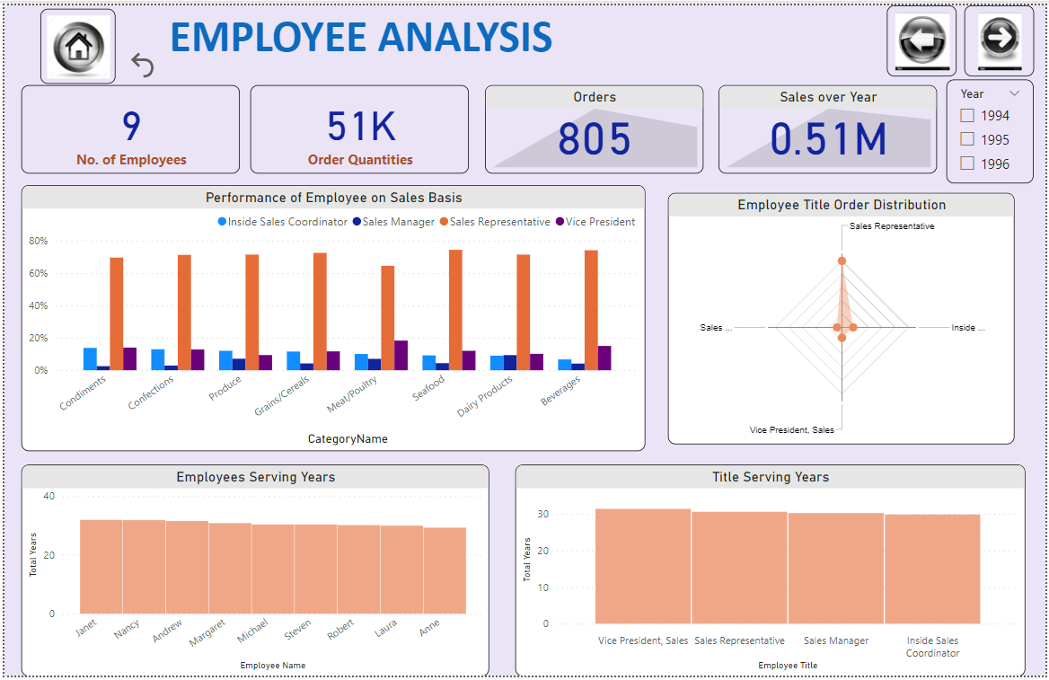

Slide 17
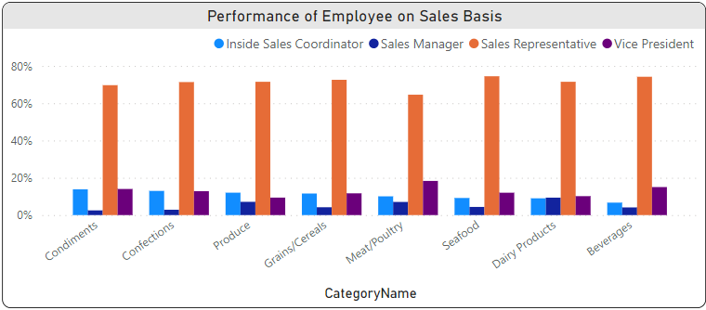
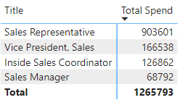
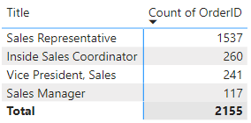
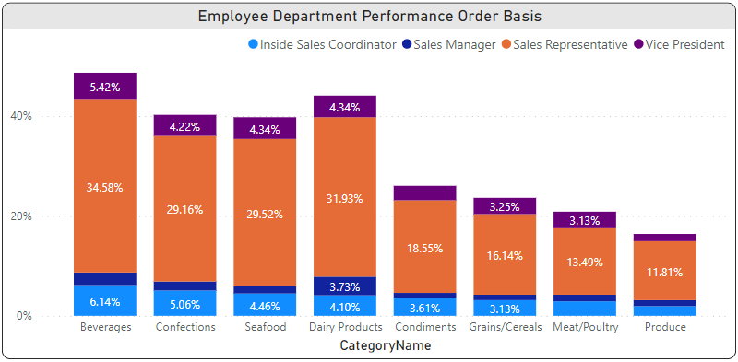
Q7: How does employee productivity vary across different departments or job roles? Can we create a stacked bar chart or grouped column chart to visualize it?
Gleaning from the Employee Analysis, one can infers from the visualization that the employee with title Sales Representative have handled more than 50% of the order and contributing a more than 60% in the revenue. We have total 9 employees to handle 2155 orders. The employee which handle the more orders contribute more in the order sales. Among the orders maximum orders handled in year 1995.

Slide 18
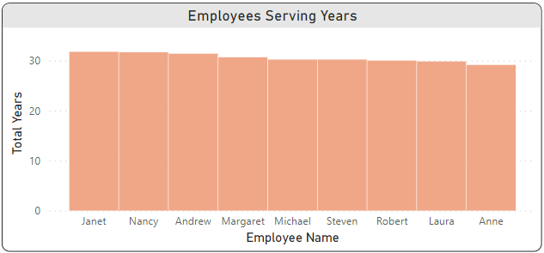
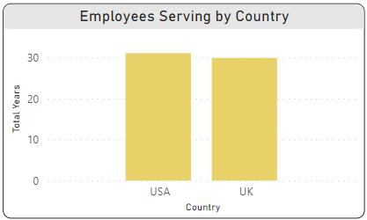
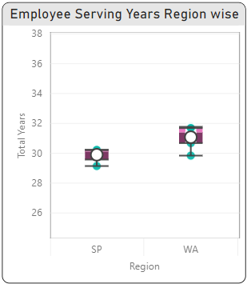
Q8: What is the distribution of employee tenure? Can we create a histogram or box plot to display it?
In the database their was no data provided for the serving time of the employees, so we assumed this year 2023 is the last day of the service. By considering this timeline we did our analysis. We can interpret from the plots that Employees average service time is nearly 30 years. The employees belongs to country USA have a average service time is 31.1 years and for UK is 29.9 years.

Slide 19
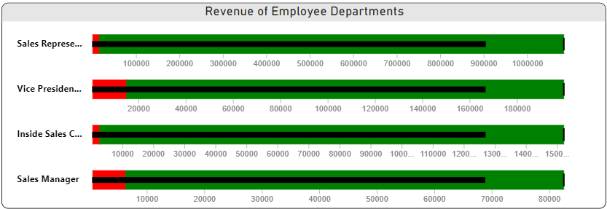
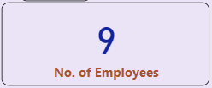
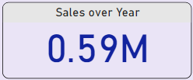
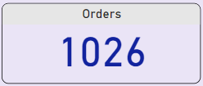
Q9: Can we visualize employee performance ratings or KPIs using a radar chart or bullet graph?
Gleaning from the Employee Analysis, to interpret the performance ratings of the employee we don’t have a direct data for it but we tried to visualize using the contribution in sales, and order handling leads to best employee. We have plotted a bullet chart to analyze the sales for the employee titles and set the target values. We found that 71% revenue share contributed by employee title Sales Representative, followed by vice president and least for the sales manager. The KPIs indicates the number of employee and orders, and sales for the year 1995. We have set a target value of sales to be 20% more to have a visualization of achieved value and goal value for the next quarter, or year.

Slide 20
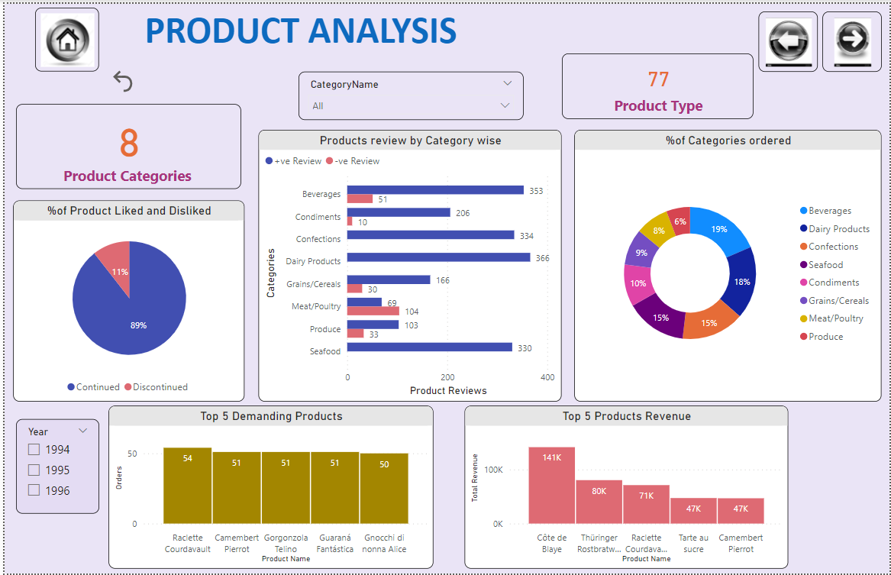

Slide 21
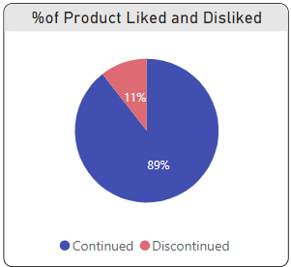
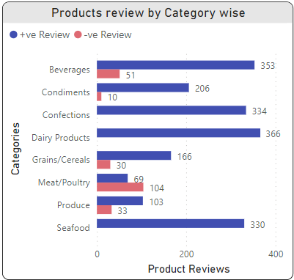
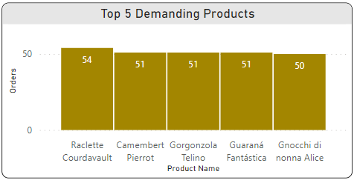
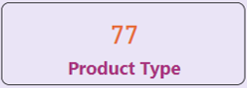
Q10: What is the distribution of product ratings or reviews? Can we create a histogram or stacked bar chart to visualize it?
Gleaning from the Product Analysis, we can interpret that there are total 77 unique products grouped in 7 categories. Some products are liked by customer and continued for the next year and it goes on for the next years. The database have a data for the 3 years of timeline shows that there are 11% of products are disliked by customer, due to their negative ratings. There are the categories confections, dairy products, grains/cereals, and seafood are the once which have only +ve reviews and other remaining categories have –ve reviews.

Slide 22
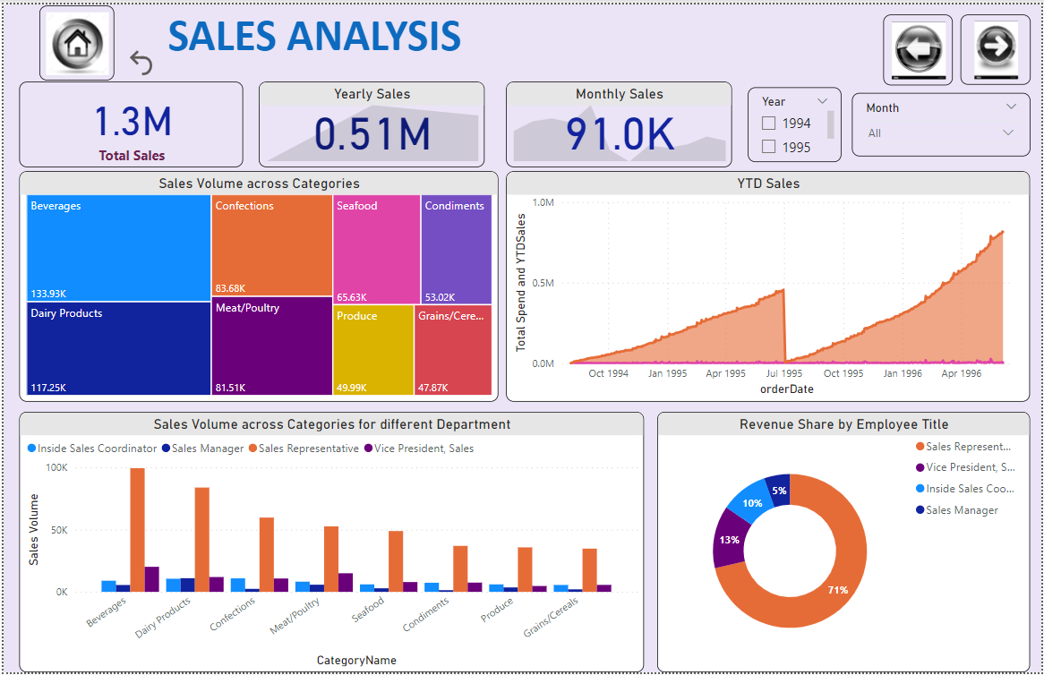

Slide 23
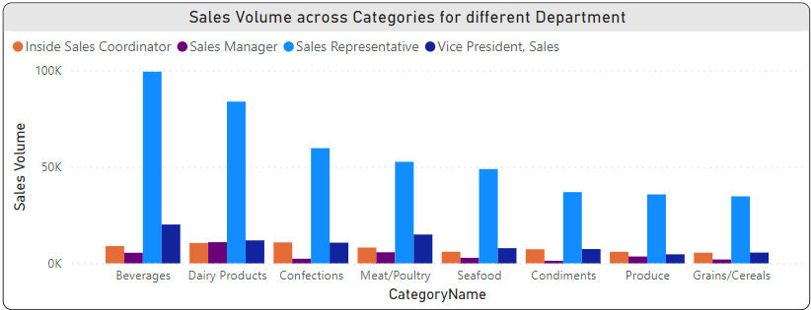
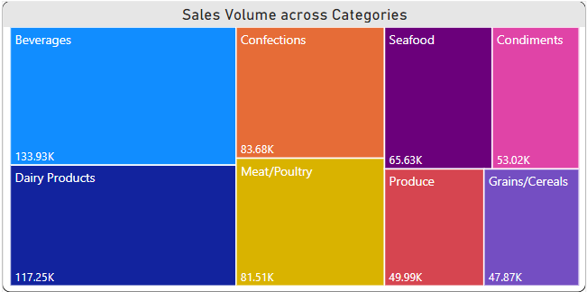
Q11: How does the sales volume vary across different product categories? Can we create a bar chart or treemap to display it?
Gleaning from the Sales Analysis, we can interpret from the bar chart and tree map between the sales and categories. The category Beverages have the highest sales value, followed by dairy products, confections and meat/poultry and least by grains/cereal. The contribution to sales by different sales title employee to different categories represents the maximum share by sales representative among each category and least shared by sales manager among each category.

Slide 24
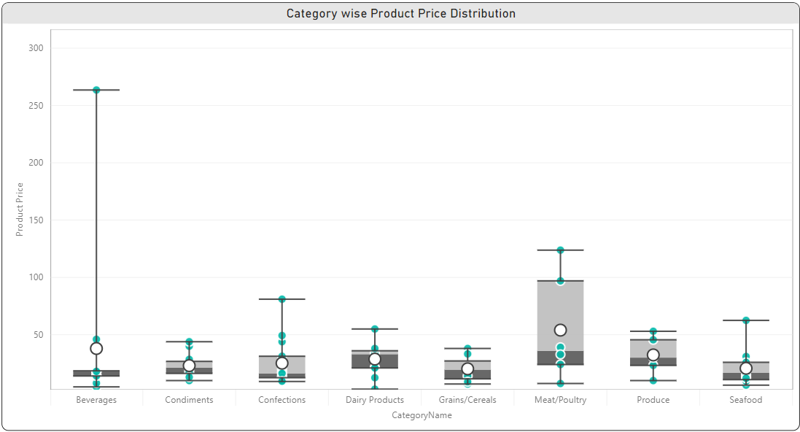
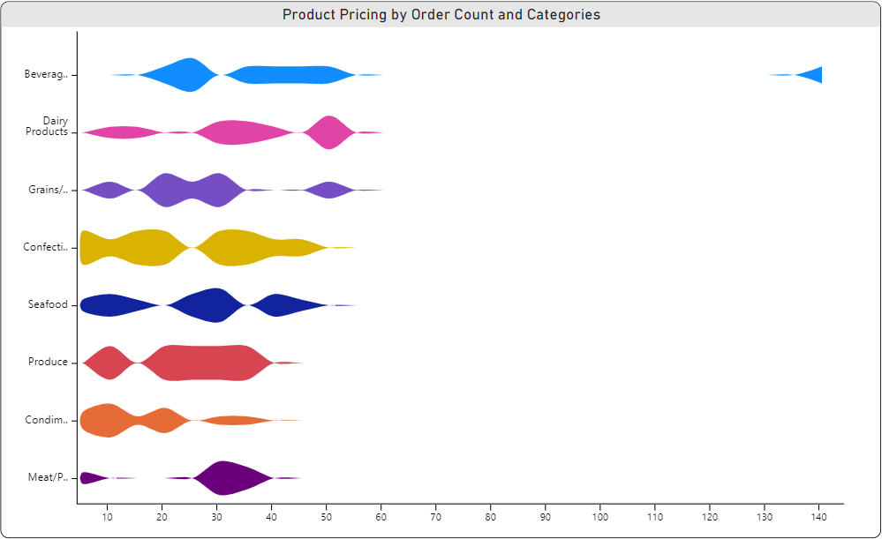
Q12: Can we visualize the pricing distribution of products using a box plot or violin plot?
The box plot and violin plot shows the distribution of pricing of products among the different categories. The plot between categories and product unit prices represents that the category beverages is the one have some products whose pricing is much higher than the other product due to which have a median value lie outside the 2nd and 3rd quartile. The distribution of pricing is been clearly visualize with the help of box and violin plot. The outliers of pricing indicates the values of products above or below the median value.

Slide 25
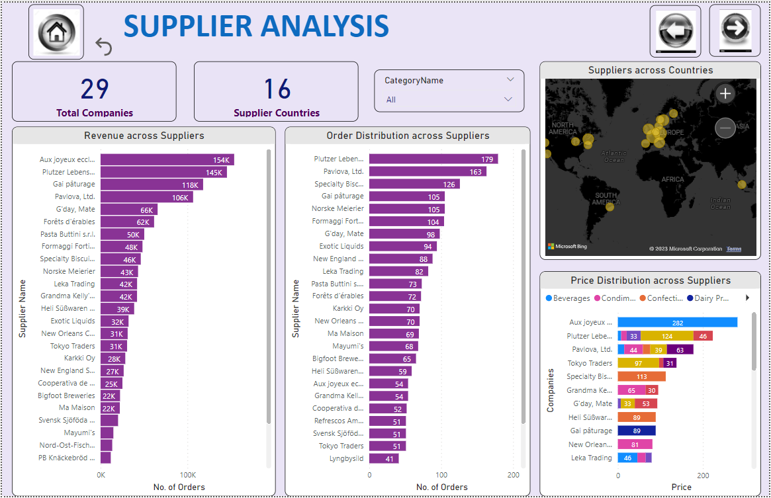

Slide 26
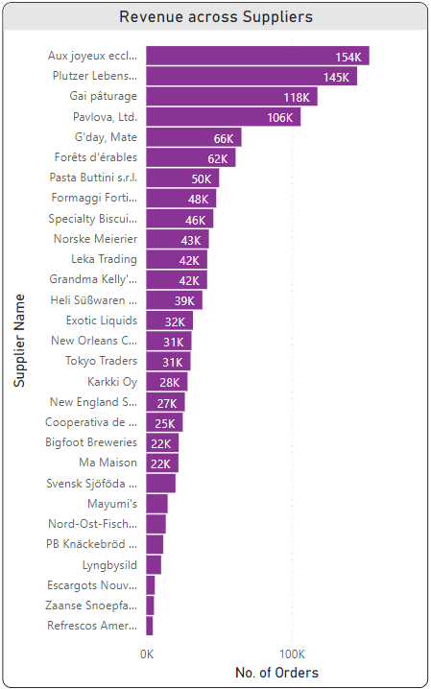
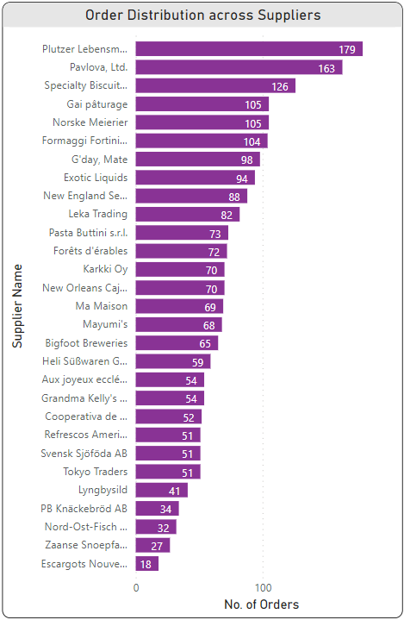
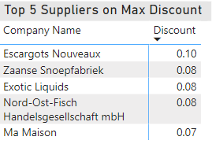
Q13: What is the distribution of supplier ratings or performance metrics? Can we create a bar chart or radar chart to visualize it?
Gleaning from the Supplier Analysis, we can visualize the distribution of sales and orders among the different suppliers. The more sales, orders done by a supplier will be categorized as a good supplier. On the basis of sales Aux Joyeux is the top most supplier and on order basis Plutzer Lebensm is the top most supplier. We have inculcate the tabular data of top most supplier giving the highest discount.

Slide 27
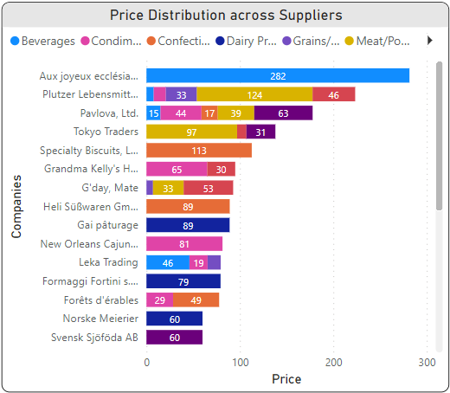
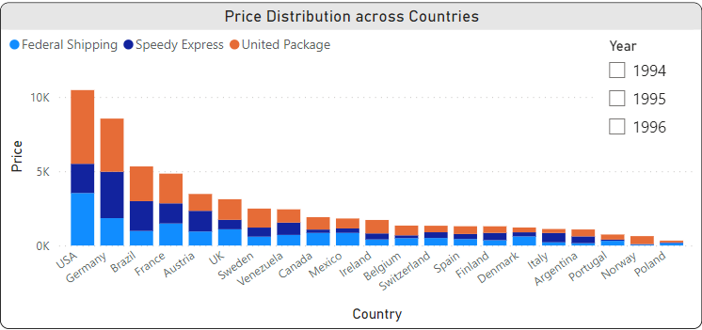
Q14: How does the cost or pricing structure vary across different suppliers? Can we create a box plot or stacked bar chart to display it?
Gleaning from the Supplier Analysis, we have plotted a stacked bar chart between the suppliers and unit pricing of product across different categories. We have found that we have suppliers which have a unit cost up to 282 and the one which cost around 4.5 for the unit pricing. Which leading us to give a range of product pricing. We have total 16 suppliers and 3 modes of which a supply made. We have also analyses the price distribution among the various countries and found that USA, Germany and Brazil have a highest unit price of products, and Poland has least.

Slide 28
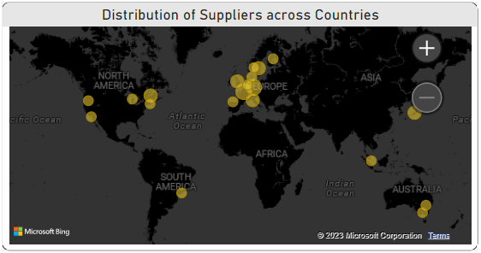
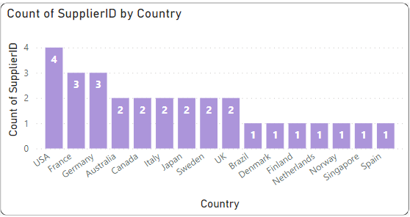
Q15: Can we visualize the geographical distribution of suppliers using a map or bubble chart?
Gleaning from the Supplier Analysis, we have visualize a supplier geometrical distribution. We found that the Europe continent have a highest number of suppliers followed by the America. We have also visualizes the distribution across countries and have found that USA have a highest number of suppliers, followed by France and Germany. Least number of suppliers for the Spain, Norway and Singapore. The geographical analysis helping us to understand the distribution of suppliers and provide a room to enhance our services in a better way.

Slide 29
EDA Problems
Statement

Slide 30
Q: What are the key factors influencing customer retention or loyalty based on the dataset?
Factors | Details
Quality of Product | Product details are mentioned in the product table providing a brief overview of the product. Product table also includes the product continued or discontinued, which provide the review of the product.
Value of the Product | As per the data provided there are varieties of product coming under the different categories and have the unit price values gives the insights about the product value.
Conveience and accessibility | There are multiple of suppliers for the product which can fulfill the demand, covering the different cities, regions and countries. Which help the customers to access the product from different demographies.
Communication | The data includes the details of the employees, phone number, their countries and regions which helps in uderstanding the cummunication between customer and employees.
Product Reviews | Their was no such direct data for it but from the product table we can understand that the product which are continued will have a +ve reviews and discontinued will have the -ve reviews which will help us in understand the in demand products.

Slide 31
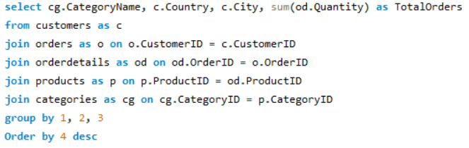
Q: How do customer preferences vary based on their location or demographics? Can we explore this through interactive visualizations?
Total orders vs Country wise stacked bar chart represents the orders for the different countries including the Categories. We can interpret from the graph that the USA, and Germany have the highest orders or product demand. Among the different product categories the dairy products are the one which have highest number of orders. The Norway, Poland, and Argentina have the least product orders.

Slide 32

Q: Are there any interesting patterns or clusters in customer behavior that can be visualized to identify potential market segments?
We have analyse the no. of customers, no. of orders, and their total spend for different countries. We found that the USA and Germany are two markets which have more customers, more orders and leads to get more sales, followed by Brazil, France, and Austria.

Slide 33


Q: Are there any specific product categories or SKUs that contribute significantly to order revenue? Can we identify them through visualizations?
% of share of total revenue by categories. We found that category beverage, and dairy product have highest contribution to total revenue by 21%, and 19% respectively. Followed by confections 13% and seafood 13%.
Top 10 product revenue for the different categories. The highest contribution of product CA te de Blaye i.e. $141.4K.

Slide 34
Q: Are there any correlations between order size and customer demographics or product categories? Can we explore this visually using scatter plots or heatmaps?
Correlation coefficient: -0.172
A scatter plot between Total orders vs category shows the correlation between them. We have found that their was a least negative correlation between the two because have a -ve value close to zero. -ve sign indicates that if one value increases other will decreases but they will not follow a relationship.

Slide 35

Q: How does order frequency vary across different customer segments? Can we visualize this using bar charts or treemaps?
The customer segmentation can be done in multiple ways, the customer who place more orders are considered to be the prime customers, the customer who spend more will be considered as a prime customer, and also the order quantity is high considered to be a priority customer.

Slide 36

Q: Are there any correlations between employee satisfaction levels and key performance indicators? Can we explore this visually through scatter plots or line charts?
Distribution of Employees vs Categories/Orders/Revenue shows the relation between them using the scatter plot. The 1st plot indicates that their was no correlation between them (correlation is zero). The 2nd plot indicates that their was a negative relation between the employees and orders with a small relation between them. The 3rd plot indicates that their was no correlation between the employees and revenue and have a negative least correlation between them.

Slide 37

Q: How does employee turnover vary across different departments or job roles? Can we visualize this using bar charts or heatmaps?
The plots represents the contribution of different employees title to total customers and turnover. The Sales representative is the one responsible for getting maximum tenure and customers because they are dealing with people and going to report to either voice president sales or sales manager. Inside sales contributor have a low scale of market so their sales are less and handling the lesser the customers.

Slide 38

Q: Are there any correlations between product attributes (e.g., size, color, features) and sales performance? Can we explore this visually using scatter plots or heatmaps?
Correlation coefficient: -0.05
We tried to find the correlation between order size and their sales. We found that there was no correlation between them and value is close to zero. Because there are certain products have different scale of sizing like kgs, litres, gms, boxes, and canes. Product cost is nothing to do with its sizing so correlation analysis of size with sales nothing to relate.

Slide 39

Q: How does product demand fluctuate over different seasons or months? Can we visualize this through line charts or area charts?
The graph shows the trend for the demand over the years. The demand increases over the years and shows the positive trend for the different seasons. In year 1995 the demand was bit high in first half of year, then decreases for the next quarter and increase in the last quarter of the year. In year 1996 we have the data for the half of the year and it shows a increment in demand.
Row Labels | Sum of Orders
1994 | 324
Qtr3 | 128
Qtr4 | 196
1995 | 1026
Qtr1 | 245
Qtr2 | 254
Qtr3 | 237
Qtr4 | 290
1996 | 805
Qtr1 | 388
Qtr2 | 417

Slide 40




Q: Can we identify any outliers or anomalies in product performance or sales using visualizations? How can this information be used for product optimization?
The figure represents the distribution of sales of different products. Mostly the product sales lie in the region of 2nd and 3rd quartile region of box. Few products whose sales are high depicts that the product whose unit price high have high value of sales and therefore they are lying outside and called as outliers.
The above figure represents the distribution of price of different products. Mostly, the product price lies is in the range of 2nd and 3rd quartile. Only four products whose value is bit larger from the mean value from products price lie outside and called outliers.

Slide 41

Q: Are there any correlations between supplier attributes (e.g., location, size, industry) and performance metrics (e.g., on-time delivery, product quality)? Can we explore this visually through scatter plots or heatmaps?
The plots represents the correlation between the shippers country and delivery of product on time/product quality. Their was no correlation between them because the correlation coefficient value is close to zero. The measures we considered for the cause of not timely delivery and quality is not responsible for it. May be their will be some other factors which can justify the correlation.

Slide 42

Q: How does supplier performance vary across different product categories or departments? Can we visualize this using stacked bar charts or grouped column charts?
The above plot represents the performance of different suppliers for the products considering the different categories. Mostly suppliers are supplying the only one category of product. Among 29 suppliers only 2 suppliers are there which are supplying the product with 5 categories. The category of product are more leads to more number of orders for the two suppliers.

Slide 43


Q: Can we identify any trends or patterns in supplier costs or pricing structures through visualizations? How can this information be used for procurement optimization?
The above chart is a dynamic chart showcase the different categories available and product type along with its price tag. This chart helps us in planning of different product purchasing so we can minimise our order price and also provide the product with different varieties.

Slide 44
Conclusions
Product Analysis: There are 77 types or products categorised in 8 categories. Mostly orders includes Beverages (19%), Dairy products (18%), Confections (15%), and Seafood (15%). Most likable products belongs to Dairy products, Confections and Seafood.
Customer Analysis: The European continent have highest number of customers. SP region in UK have highest number of customers. Customer acquisition is increases throughout the timeline and have a sudden fall after end or 2nd quarter on 1996 because month June be considered as a financial end year.
Order Analysis: Total 2155 orders has been delivered till the year 1996 & have 28 days of processing time, and 21 days of shipment. The orders are increasing throughout the time line & have a sudden fall after the end of 2nd quarter of 1996.
Sales Analysis: Total sales of 1.3M have been completed. Highest sales registered for the category Beverages followed by Dairy products, Confections, and Meat/Poultry. June is considered as the year end and sales increases throughout the timeline. The sales representative have 71% contribution in total sales.
Employee Analysis: There are total 9 employees in 4 department handling the total orders worth of 1.3M. Most of the orders are completed by the sales representatives & have a 30 years of average tenure.

Slide 45
Supplier Analysis: There are total 29 suppliers distributing the product to 16 countries. The highest revenue registered by Aux Joyen followed by Plutzer gai Paturage and Pavlora Ltd. Maximum discount offered by Escargo Nouveax.
Freight Analysis: The company have 3 shipping modes or suppliers and 16 shipping countries. The highest cost paid by Austria for the shipments. There is a strong +ve correlation between the number of orders and freight charges.

Slide 46

Thank You

